Slide 1
WELCOME
TO
BULENDI ANTI-TOXIC LIVING VILLAGE

Slide 2
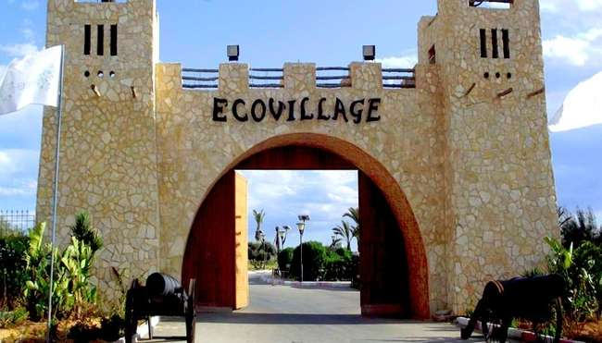
BULENDI
BULENDI

Slide 3
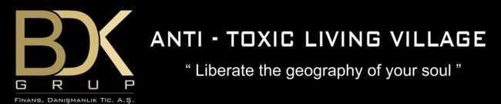
ABOUT BDK GROUP
The service sector has existed almost since the existence of civilized societies.
The common thought in service is development and change. Developing, sharing and transferring knowledge, which is the basic rule of progress, also forms the basis of BDK Group Financial Consulting. BDK Group Financial Consulting works to serve humanity with its humanistic structure and to transfer knowledge to the future.
OUR POINT OF VIEW
BDK Group believes that the financial consultancy, real estate and real estate-based financing sector will gain great importance in Turkey. For long years already it is at the top of the list of Turkish economy. Real estate-based sectors are also indispensable parts of the world economy. The increase in the use of real estate as a financial resource in our country is the most important indicator that supports this idea. We see that foreign capital does not only purchase real estate, also professional service companies are positioned in our country.

Slide 4
The main purpose of BDK Group Financial Consulting is to reach investment targets in the most accurate way by using the existing conjuncture resources in the most efficient way which set out with the promise of "Investment is in the safe hands'' and believes in the power of domestic capital .
BDK Group Financial Advisory; adds value to the investment by combining information and technology.
OUR VISION
Our vision is to be a brand by creating the difference without saying "We are different"; adding value, maximum benefit and minimum commercial concern and to build structures which prefered by who know how to choose.
OUR MISSION
The most important need of human history is the need for shelter. Our mission is transforming safe and aesthetic buildings that we have produced with an innovative architectural understanding into living spaces where you can "enjoy life". Because we do the best in sector and we know what you need!
As BDK Group Construction, we produce, environmentally friendly, safe places where you can live in peace and compatible with the changing and developing city life. We provide maximum satisfaction by contributing to the quality of life.

Slide 5
Crossing our paths with the right solution partners, from design to architecture, from planning to production, using the most advanced technology and the most suitable materials. Our executives, staffs and solution partners always working with the highest quality by conducting harmonious partnerships with our partners .We provide the conditions. We know very well that; power comes from unity .

Slide 6
WHY ECOVILLAGE ?
Increasing population, traffic, building density, air and environmental pollution, decrease in living spaces, increase in carbon rates, decrease in natural resources, toxication and increasingly unhealthy living conditions in today's cities and metropolises disrupt the ecological balance and destroy the unique dynamics of the natural environment.
The rapid growth of industrial cities is accepted as the main cause of disconnection from nature and urban problems, and the solution is to reunite with nature and to create alternative living spaces. This is both an escape and a remedy against urban areas becoming uninhabitable in the distant future. So constructing alternative living spaces against the problems caused by urbanization has led to the emergence of many eco-villages. Eco-village settlements, the first examples of which were seen in the 1950s, and today, meeting the needs of the communities in the industrializing world at the optimum level and offering different experiences, have been an increasing trend for the last thirty years and causes people to become alienated from the environment in which they live. Eco-villages, which are an application area of rural tourism, have developed with the change of social structure and the differentiation of socialization expectations of communities who want to integrate traditional rural life into life.

Slide 7

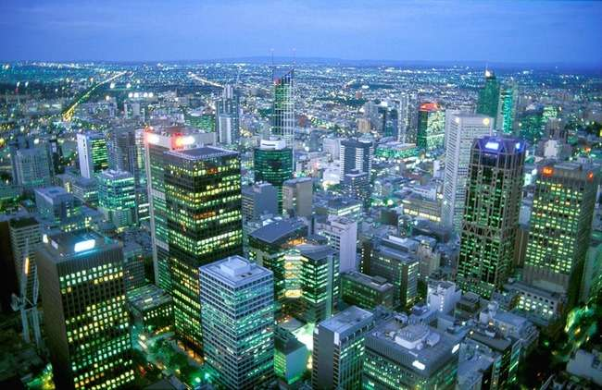
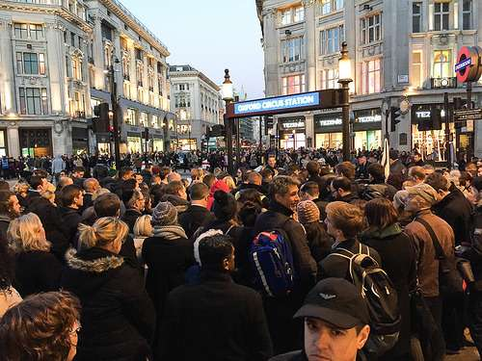
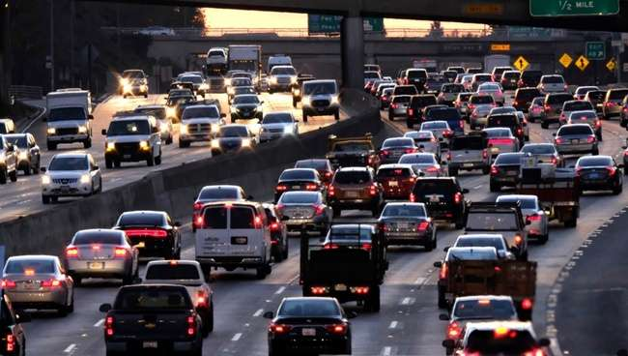
DO YOU ENJOY THAT LIFE ?
The stress of urban life

Slide 8
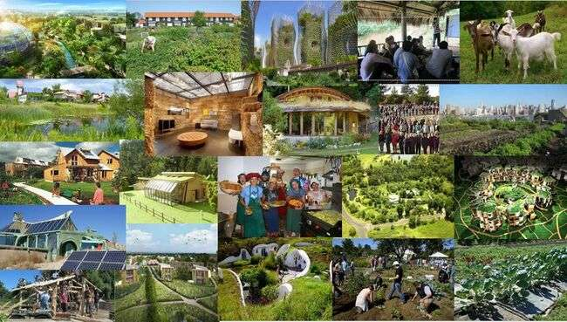
OR DO YOU ENJOY THAT LIFE ?
Freedom and peace in the nature

Slide 9

What we want in that project

Slide 10
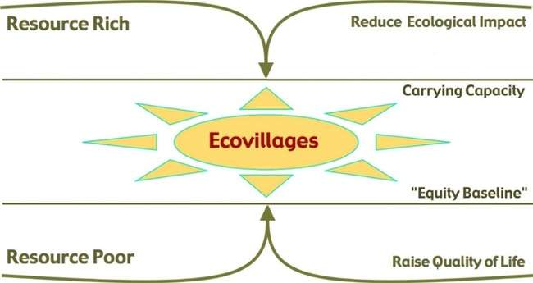
WHAT IS ECOVILLAGE ?
We can describe eco-village is a full-fledged settlement at human scale, which supports healthy human activities and enables them to continue successfully into an undefined future, where human activities integrate with natural life without harming them.
Established in 1995 to support ecovillage initiatives, the Global Eco-village Network (GEN) defines the concept of eco-village as follows: An eco-village is based on local participatory processes and has social, cultural, economic and ecological dimensions to ensure sustainability. It is a consciously and intentionally established traditional or urban community that unites it in an entire system, actively renewing and revitalizing the social and natural environment.

Slide 11
If we count the features that should be in ecovillages
Ecovillage is an ongoing process, not a specific outcome. Every ecovillage is a living and learning center, a place of constant discovery, for a regenerative future.
Although many ecovillages start with a strong focus on the ecological dimension, ecovillages do not focus solely on ecology. Conservation and restoration of nature can only be successful when the social fabric is strong, cultural heritage is celebrated, and people find ways to unite their love for the world.
An Ecovillage is not a particular outcome, but an ongoing process. Each ecovillage is a living and learning centre for a regenerative future, a place of continuous exploration
In ecovillages, the understanding of not suppressing the individual and the happiness of the individual, the peace and well-being of the community in general is dominant. Since the individual is important, no one has to do the job they don't want, each individual deals with jobs that suit their abilities and preferences.
Although there are concepts such as organic agriculture, ecological tourism, a life intertwined with nature and waste-free, efficient use of resources, and protecting nature that come to mind when it comes to eco-village, there must be more: future models of life must also be designed.

Slide 12
Eco-villages are places that offer special services to communities seeking diversity, where environmental and cultural values gain importance in the continuation of natural life and the survival of traditional culture, and units with social experience-based activities and special design approaches.
8 ECO-VILLAGE SPECIFIC IDENTIFICATION CRITERIA
Developing a new lifestyle
Commune life perspective
Solving urban problems
Proposing a settlement
Creating a holistic system
Interpretation of eco-village formation
Structural structure
Creating a common vision

Slide 13
OUR CRITERIAS FOR DETERMINING THE PROJECT
In our project, we imagined an area where individuals of today and tomorrow can continue their individual and social development in a clean atmosphere and healthy environment, in harmony with nature, for a sustainable life. With this approach, it is aimed to design a “living” ecovillage project.
Some of the ideas that inspired us were:
  Connect: Society-Nature-Technology
  Antitoxic: Sport Village , Wellness Coming from Nature
  Symbiosis: Living Together with Respecting Personel Lifes
  Ecowill: A Sustainable Future
  Rehabilitation: Refreshing Yourself
  Enjoy: Feeling the Real Taste of the Life, Peace and Smile

Slide 14
Sportive Development
Social Development
Increasing General Capacity
Social Activities
Increasing Performance
Organizations
Increasing Concantrate and Tactics
Learning natüre in society
Health Development
Ecologic Farming
İmproving Healthy
BULENDI ECOVILLAGE
Learning Farms
Building a Healthy Future
Ecologic Farming training courses
Emergency Response
Developing the ecological,health,rehabilitation and sport capacity of society
Animal husbandry
Rehabilitation
SPA
Personel Issues
Bath and Relax
Behaviour Issues
Saunas and weight control
Development Issues
Massage and teraphy
Development of Functions in Bulendi

Slide 15
We thought and designed to create compact living spaces in nature and with as little interference as possible, and to accommodate all private and public spaces to meet all the needs of the people in this residential area.
In project scope; permanent and temporary (tourist) residences, hospitals and rehabilitation centers, sports fields, Turkish baths and saunas, shopping malls, design and production workshops, seminar halls, restaurants, places of worship, agricultural and animal production areas, playgrounds, greenhouses, solar energy panels, There are also water tanks, pastures, biofuel production center, petrol station and landscaping.
PROJECT AREA (Neighbourhood of Kaz Mountains)
In our country and in the neighborhood of Kaz Mountains where is the project area its clearly visible the ecological tourism potential has been determined and it has been set out with the aim of spreading these activities throughout the year. There is not another big eco-village like we designed in Turkey. The theme of “Anti-Toxic Ecological Sports Village” has been adopted, taking into account the convenience of the natural structure and the oxygen reservoir of Kaz Mountains.

Slide 16
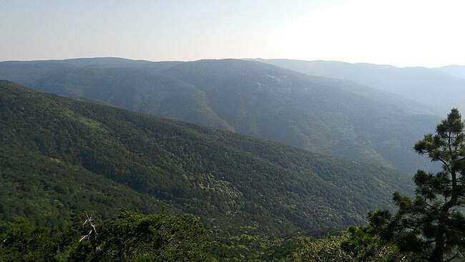
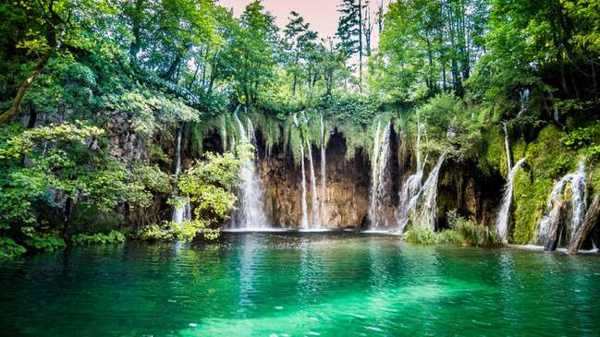
Kaz Mountains has the second cleanest air in the world with the second highest oxygen rate. Potential areas have been identified with agro-tourism and accommodation areas, hiking routes, natural rehabilitation and contemporary treatment. With the sports village theme, it is also aimed to create an eco-village. Agricultural areas, which are important in terms of collective living and productivity awareness, are another common area to be considered.
KAZ MOUNTAINS

Slide 17
Workshops, hobby gardens, health facility, sports facility, school, festival area, art centers, education centers, spiritual education unit demanded by the participants are located in the eco-village, bicycles, non-motorized vehicles and public transportation are developed as priority transportation models. - Parking lot will be solved at the entrances of the village or residential clusters. Pedestrian, bicycle and public transportation-oriented transportation plans are made.Village’s living space that is zero waste, self-sufficient and free from all bad energies.
Services that can be offered to visitors can be summarized as festivals, local productions, traditional and cultural activities and active participation in village social life.
Within the scope of the project, there are also rehabilitation centers, jogging areas,swimming pools, design and production workshops, seminar hall, restaurants, cafes, places of worship, playgrounds, greenhouse, solar energy panels, water tanks, pasture and biofuel production center.
Roads for the disabled, vehicles, bicycles and pedestrians are separated in the ecovillage, the use of bicycles and electric vehicles is encouraged, and vehicle entry into the ecovillage is restricted unless there is an emergency. In the place with the steepest slope of the land, a water collection basin was designed and it was aimed to use the collected water in agriculture and irrigation with the help of canals and reservoirs.

Slide 18
All buildings in the project will be designed as "one or two storey" and "serender", and wood or ready-made panels will be preferred as building materials; The use of chemical varnishes, synthetic dyes and other chemical materials is not recommended. The water obtained from the roofs is collected in the tanks and it is aimed to use rain water. The roof surface will be covered with photovoltatic panels and solar shading will be designed on transparent surfaces.
Different plan types of houses are kept flexible depending on user preferences with a modular system according to the preferences of the people. The fact that the buildings are multi-storey gains importance for the establishment of an elderly and disabled-friendly layout.

Slide 19
BULENDI SOCIAL AND ACTIVE LIFE
We are sure you will glad to live the unique life that you have never met before at BULENDI Living Village ! When we say healthy life, we are not talking only about physical health, but also a quality life in which people feel healthy in their soul and inner world.
From sports to art, from cultural discoveries to details that connect people in natüre.. at BULENDI, we offer solutions to meet all your needs and have a pleasant time. We people sometimes revive old habits and open the door to new pleasures. In BULENDI this kind of sentences are overriden. Whether you have a pleasant time to watch a play in the theater or enjoy the special tastes with a friendly service. Dine with your friends in our restaurant where it is served, whether it's a hobby be the most talented face of their workshop or spend time with your loved ones ... Whatever comes to your mind, it’s private areas are just a few steps away !
Services that can be offered to visitors can be summarized as festivals, local productions, traditional and cultural activities and active participation in village social life.

Slide 20
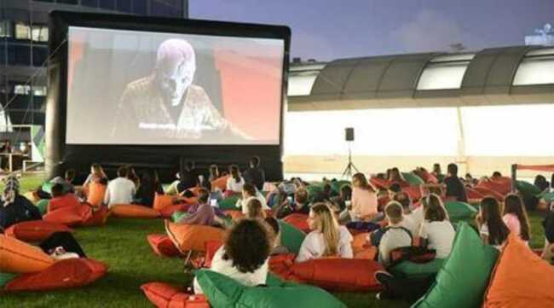
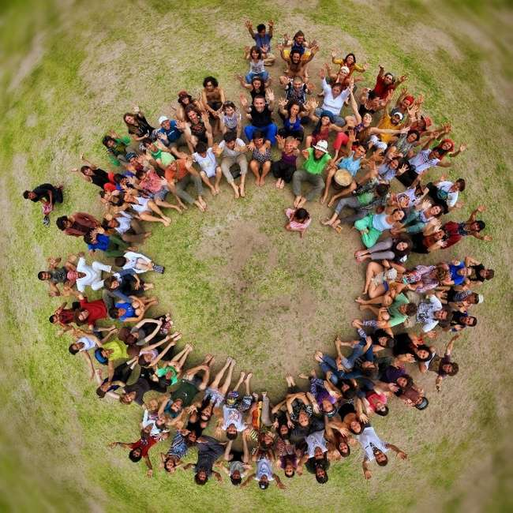
Since the year of 2000, BDK Group Financial Consulting Tic. A.S. has been in communication with its customers with a humanistic perspective beyond shopping with its ethical approaches in the construction industry. BDK Group Financial Consulting Tic. A.S with the idea of Joint Investor and which has the idea of "Strength comes from their work; signed a joint project on 22.10.2020 for a brand new project. On behalf of all humanity, we have rebuilt the benefits of ecological life into our lives with the extraordinary life village.

Slide 21
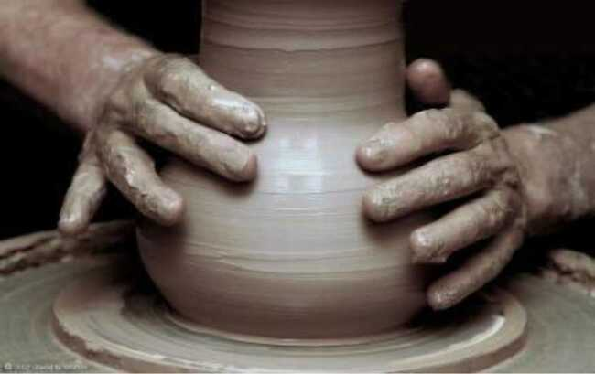
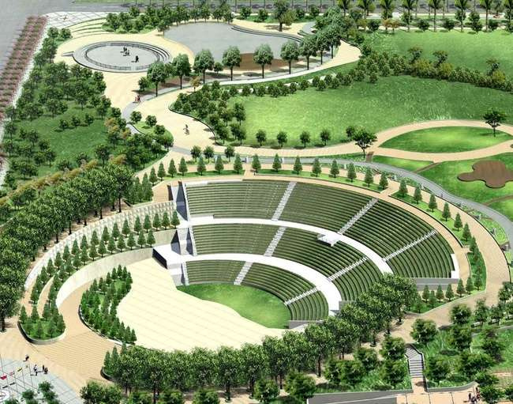
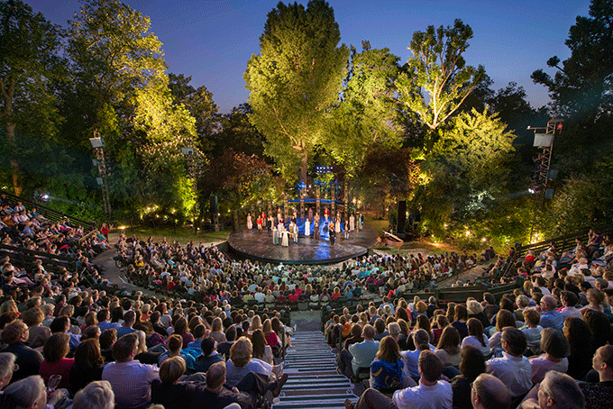
We have opened workshops that you will enjoy. Within the scope of the project, by the three-day program Workshops, Events and Training will be held. Leadership Program for Child and Youth Studies. Join us now! Contact us. take action . Be with us to progress on this path. Take your place in the healthy life village with www.bdkgroup.com.tr and request the details, don't be late.
We focus on the environment of buildings and their relationship with people. The aim of sustainable architecture is to produce buildings with minimum energy consumption and minimum damage to the environment.

Slide 22
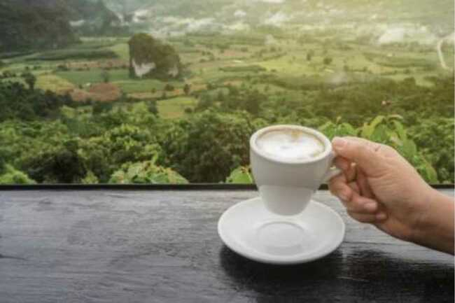
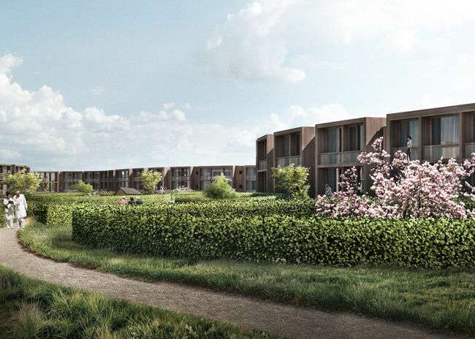
We have prepared some of the special areas for you to get rid of your past in the nature with the oxygen tank in the Kaz Mountains. to make you live the most meaningful times in your life. We have opened a country cafe for those who miss coffee.
One of the most important features of sustainable architecture is to give priority to renewable energy sources and to use energy effectively in the area where it is located. Sustainable architecture is architecture that aims to minimize the environmental impact of buildings in the use of materials, energy, development space and ecosystem in general. Sustainable architecture uses a conscious approach to energy and ecological conservation in the design of the built environment.

Slide 23
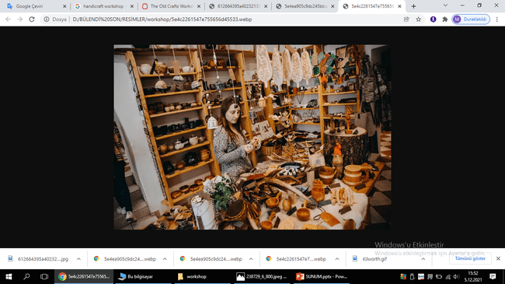
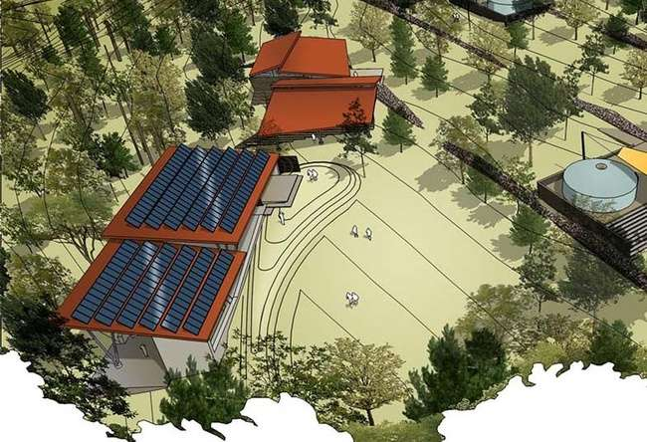
In Bulendi Handicraft Workshops you have all to design where you can reflect your free spirit or build your own ideas.You will regain your rhythmic life energy in to your whole soul in the life village. In the unique nature of the Kazdag Mountains, you will feel safe and your whole body's cells have been renewed.
For BDK Group the idea of sustainability or ecological agriculture is to ensure that our use of currently available resources to not have detrimental effects on our collective well-being or not to make it impossible to obtain resources for other applications in the long run.

Slide 24
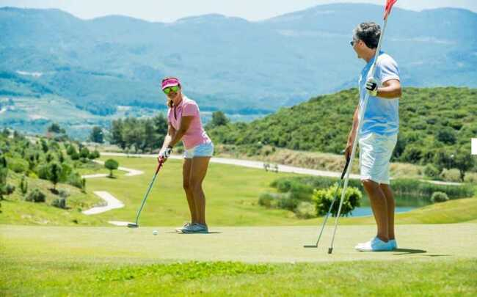

We also built a golf course for golf pleasure.Our project is specially designed for you to suspend the times you always say tomorrow,in this way you add your hobbies for your and your close friends's life.
How many times have you experienced the most beautiful feelings in the world, how many novels have you read? We are determined to rebuild your life from the ground up. We opened a library where you can read rare books.

Slide 25
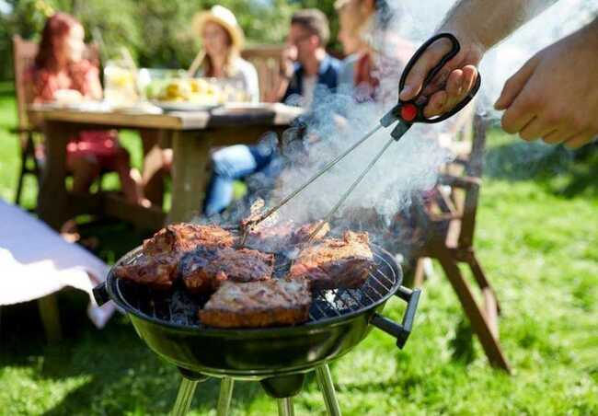
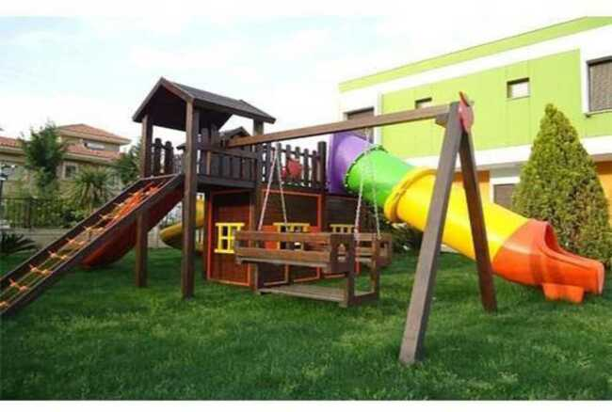
Have you ever thought about how many beautiful! Sundays have passed in our lives that we wanted to enjoy but we couldn't? We turned every day into a Sunday from the vegetables you grew from your own garden for you.We have reserved a picnic area to revive the picnics that are enjoyed on Sundays.
We made playgrounds for children. We have carefully designed every moment for your children and grandchildren.We have prepared active playgrounds for every day with a childish excitement and hope.

Slide 26

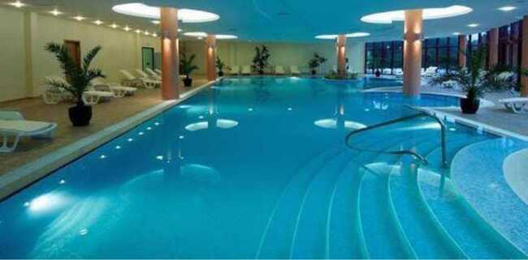
Wouldn't you like to start every day with the help of our most successful teachers and doctor's control, which is necessary to calm and relax our whole body and soul in our joints with tension and resentment every day of our lives?
Therapeutic massages are waiting for you to calm down and relax.
There is a swimming pool for those who cannot get away from the beauty of the water. Think about how much we say water is life and take it into our lives....
Even our body has 60% of water. Swimming will make our whole body and body always fit and renewed . The most beautiful swimming activity is specially designed for you.

Slide 27
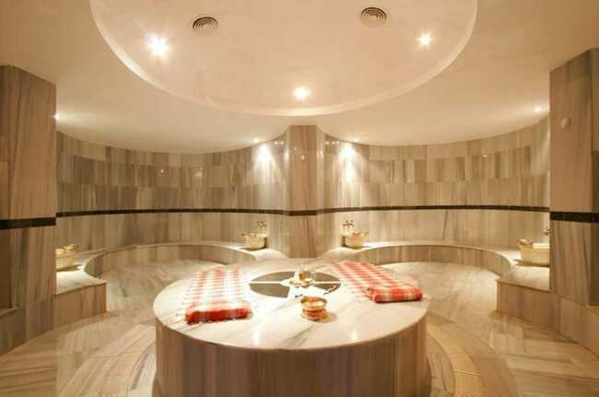
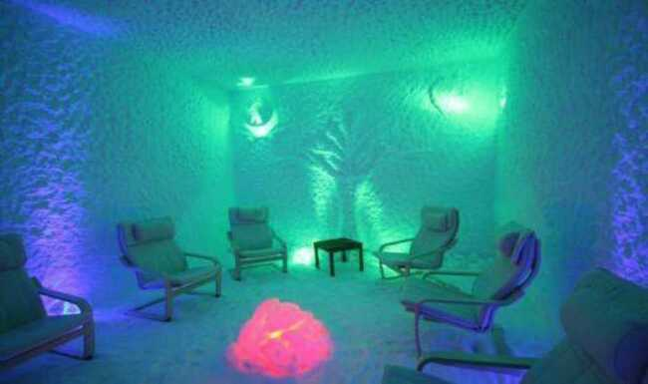
We have straw in our roomswill open the bronchi by sweating for who find the sauna hot.
You will come out with a healthy breath from the salt rooms that are the solution to respiratory problems.

Slide 28
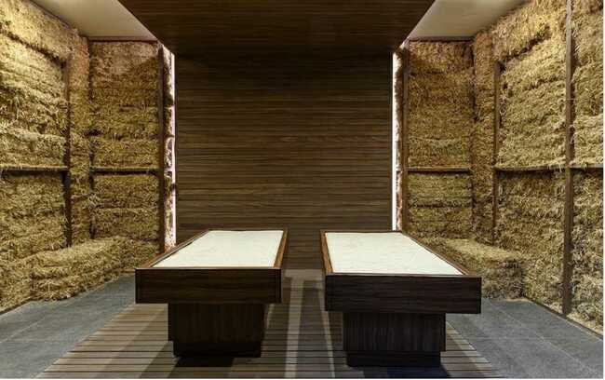
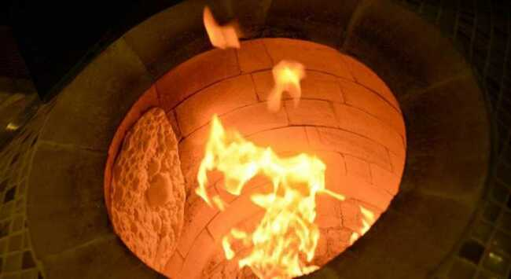
We have straw in our roomswill open the bronchi by sweating for who find the sauna hot.
Real tandoor ovens where you can cook your own traditional meals.

Slide 29
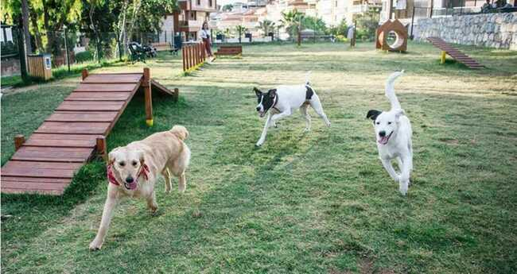
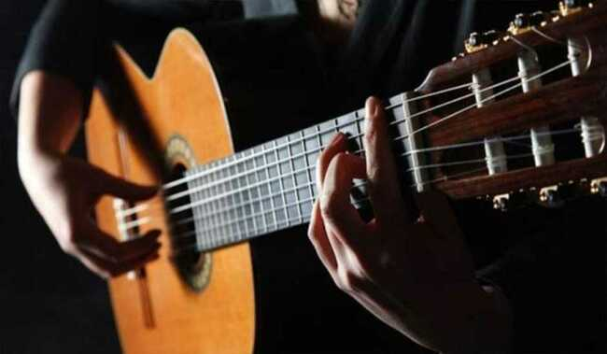
We also thought of places where your pets can throw their energy away.
Rest your soul always. Wishing you wake up to peaceful and happy tomorrows with your spouse by music concerts and courses are waiting for you.

Slide 30
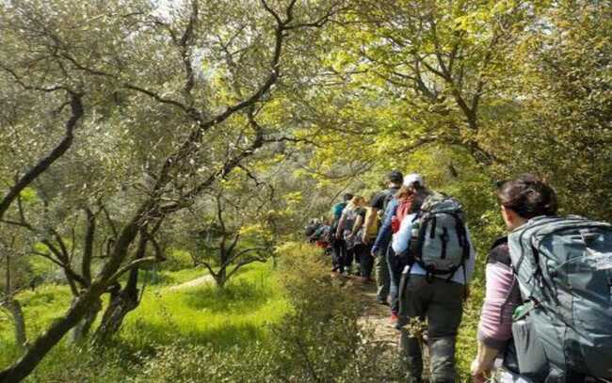
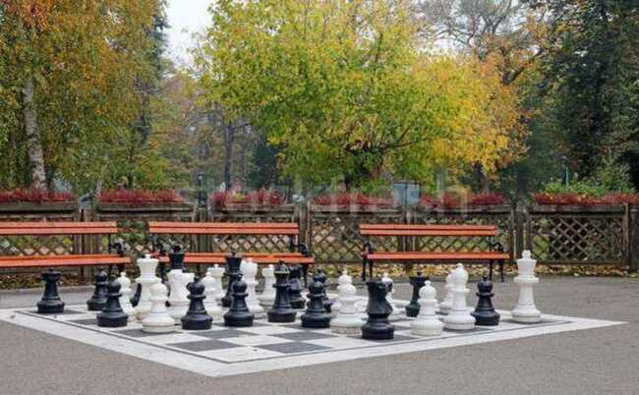
We have prepared nature, and culture walks for those who can't get enough of travelling .
You will not be able to understand how the time passes with enjoyable intelligence games that you will play with your friends.

Slide 31
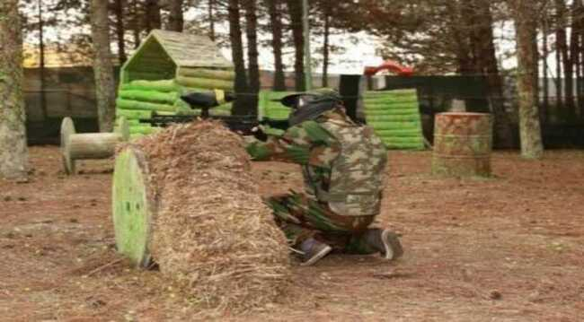
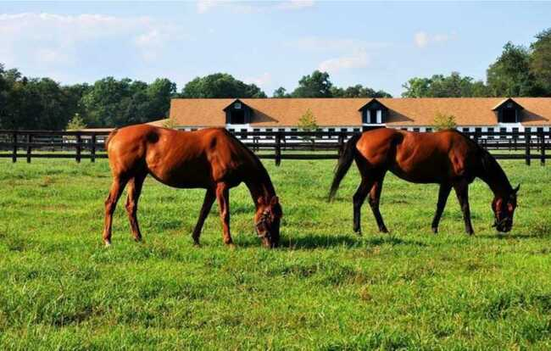
We have created a different stress relief environment for people who love paintball.
We have also prepared a suitable environment for people who love horse riding

Slide 32
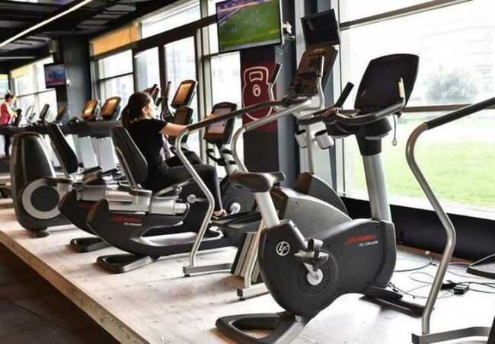
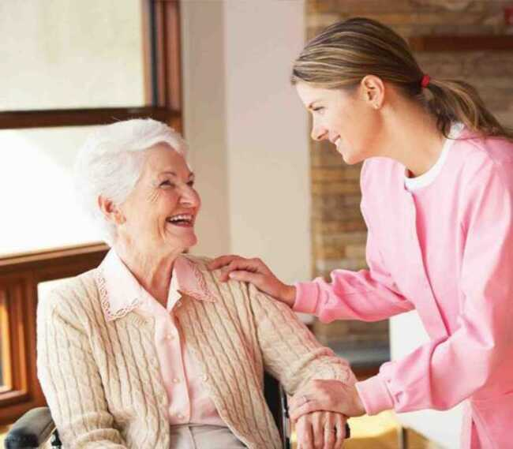
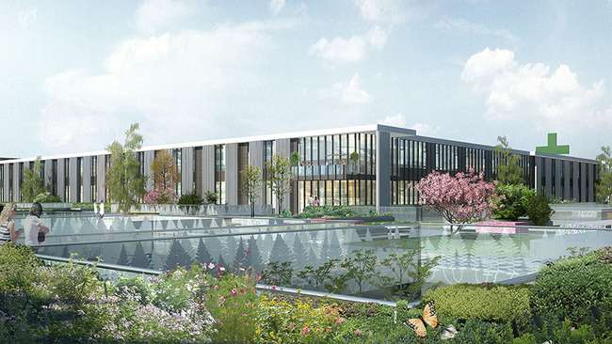
BULENDI HEALTH LIFE
Health is the most precious treasure of human being. Moreover, with today's opportunities, it is possible to lead an energetic, happy and enjoyable life. 24/7 supervision of doctors and nurses, psychologist, physiotherapist and dietician when needed. Ready ambulance for 24 hours a day. All with the assurance of BULENDi Health Group.
We have designed exercise areas to keep you fresh all the time. We have created a system where specialist doctors and nurses will be available 24/7. The most beautiful wealth on earth is our health. And we are at your service with our expert staff so that you are always safe.

Slide 33
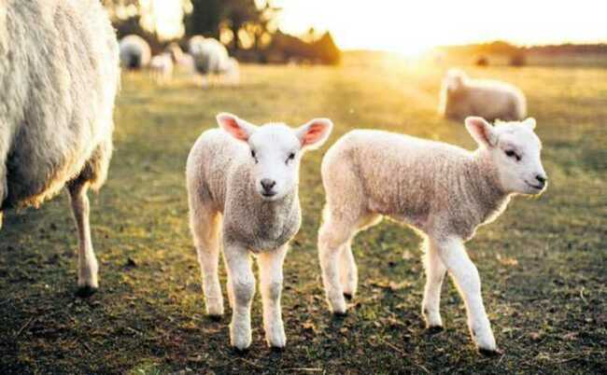
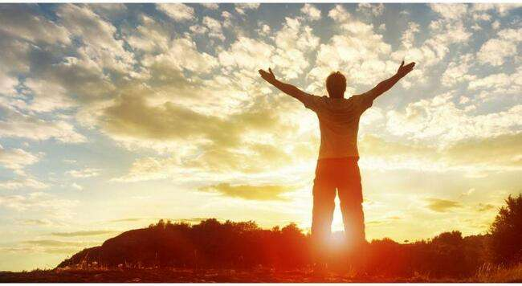
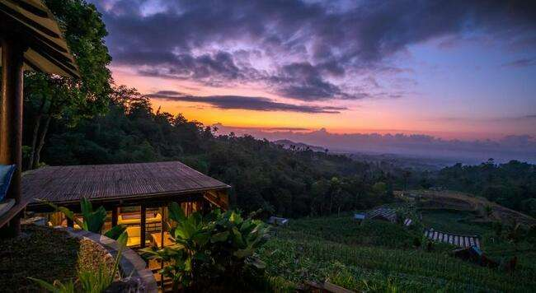
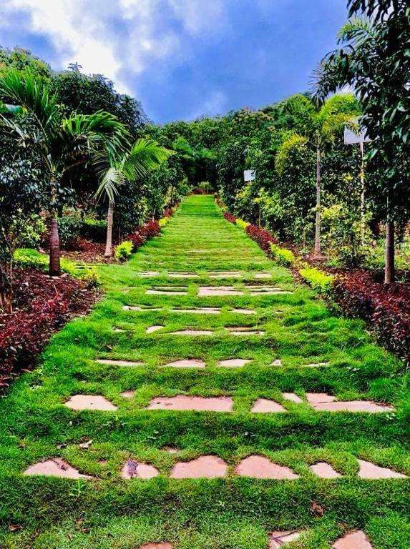
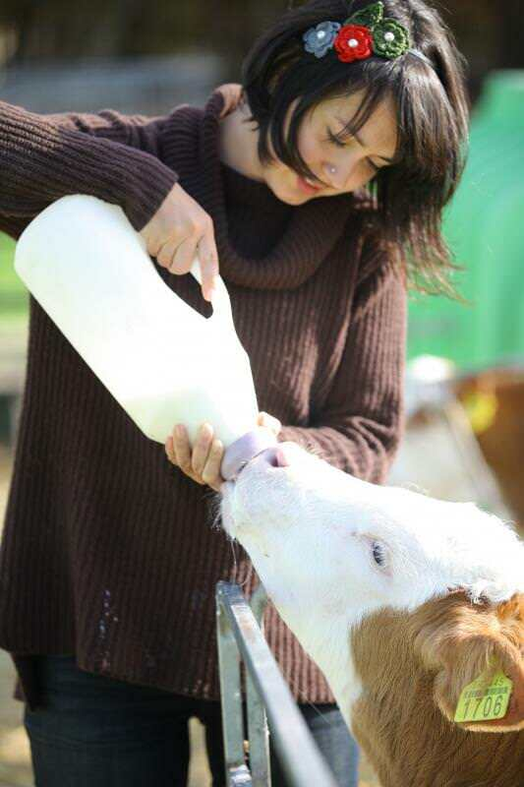
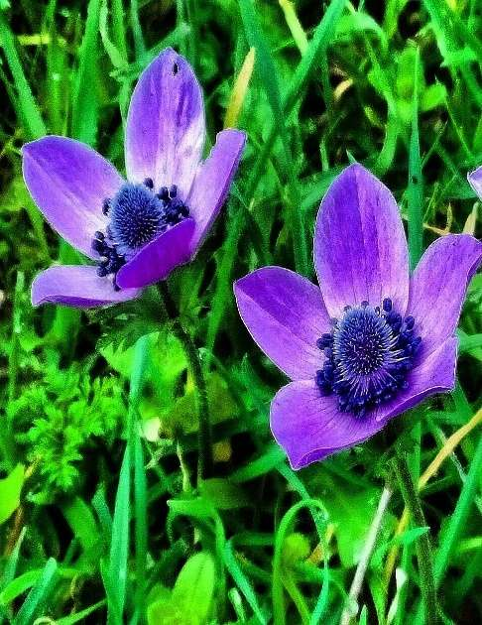
The nature is waiting in Bulendi for you and your family TASTE THE REAL LIFE !

Slide 34
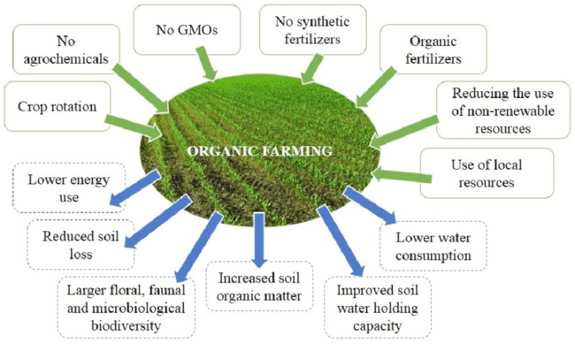
ECOLOGIC AND ORGANIC FARMING IN BULENDI
We learn a new information about natural life every day. Ecological and organic products, natural farming practices, natural recipes... In Bulendi is possible to eat fruits and vegetables that you have grown with your own hands and more . We established a farm for you to remember the sound of lambs and cows in the village with the naturalness .
The main principles and effects of organic farming

Slide 35


Slide 36
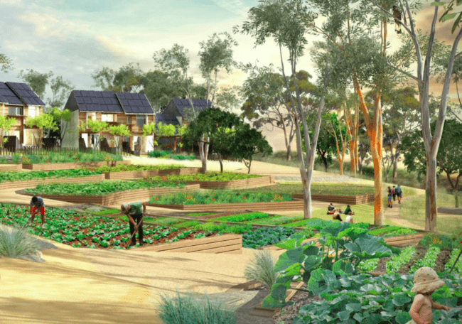
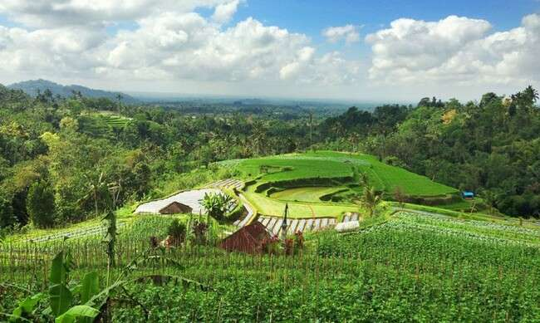
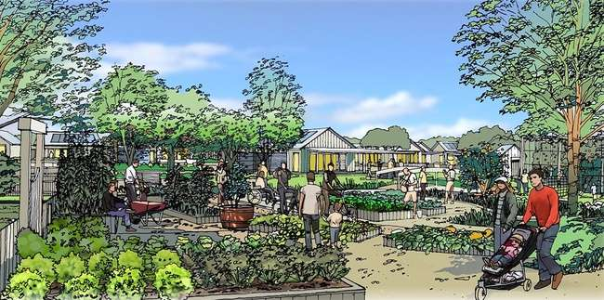
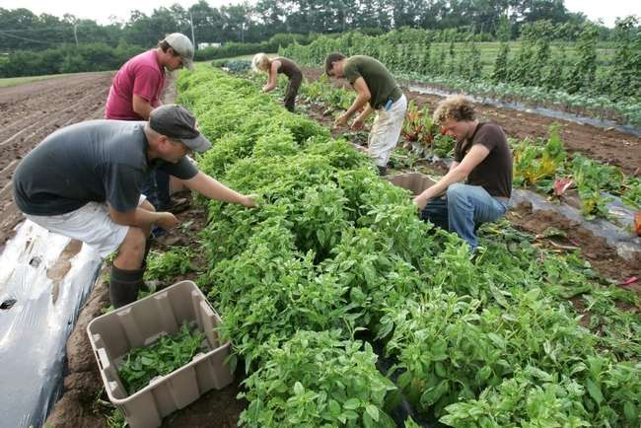

THE ECOLOGIC AND ORGANIC FARMING WE WILL CREATE IN BULENDI !

Slide 37
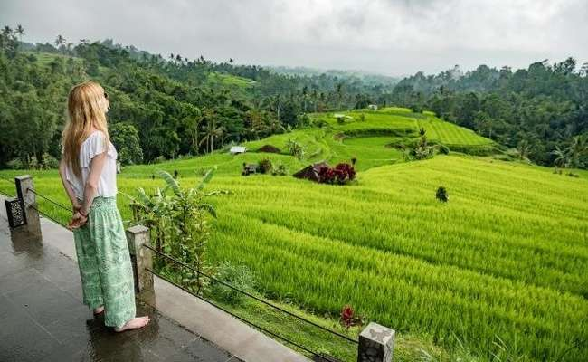
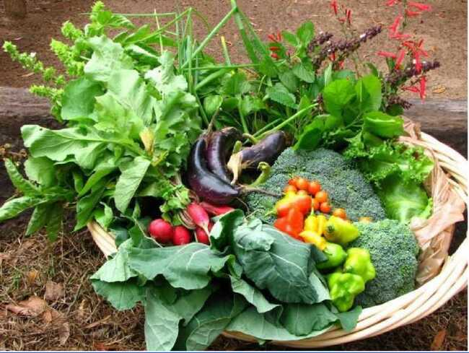
We open courses for you to learn farming and ecologic farming.
We also open courses on food so that the smells coming from the kitchen will always last.

Slide 38
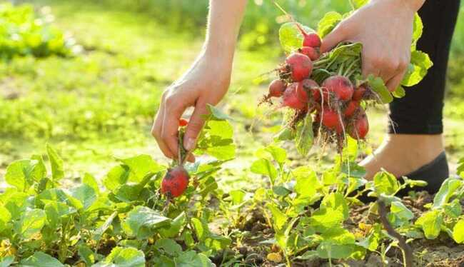
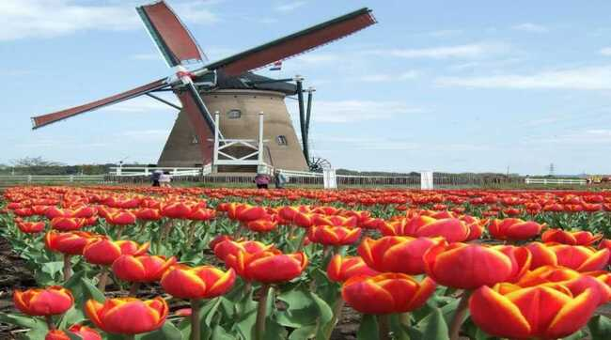
Hobbies that you never experienced in your life. We have added a hobby garden to your home so you can cultivate as you wish always with your positive energy.
We also have a Windmill to grind your wheat in a natural environment.

Slide 39


As a hobby, you can bring ornamental chickens from countries such as the Netherlands, China, Romania and Belgium together in the coop and take care of them.
We are sure that touching our lovely friends and feeling their being will be an extraordinary experience for you.

Slide 40


We have coops for collecting organic eggs of our village.
Our barn where the freshest milk of our village is milked

Slide 41


Ecological production is provided by electricity solar energy.
We supply our water from natural sources in Kaz Mountains

Slide 42


We also prepared a field that we cultivated together and where we you can carry your product with your own hands.
It is available in our therapy environments with private teachers where you can be comfortable.

Slide 43



You can enjoy have a shopping in our environmentally friendly shopping center. Solar/LED lighting, energy efficient heating and cooling systems, waste reduction, and green spaces will be in our shopping centre.

Slide 44


We have prepared our all buildings as smart buidings contemporary
We used voice and remote motion sensors

Slide 45

With every day you are in this project, your feelings of gratitude and excitement in life will increase, and your happiness will be our pride for us. Thanks to the peace of eternal nature.

Slide 46
SERVICES IN BULENDI
You can find the services and facilities you need in the most comfortable way. We brought all the services together that you can think. Whether you're ordering food for the house or for a renovation job call the staff, or place your daily orders if you want... We thought every details meticulously so that you can live your life as you wish. If you have a different request, we are working with our strength to fulfill them . What is important to us: make everything easier for you, to offer a more comfortable and happier life. That's why our services are unlimited!
OUR SERVICES
• House Cleaning • Home maintenance/repair service
• Home meal service • Restaurant
• Cafeteria • Market
• ATM • Pharmacy support services
• Dry cleaning • Hairdresser
• Laundry • Daily fresh milk and eggs from the village farm
• 7/24 Our successful healthcare team
and clinic at your service

Slide 47
A DAY IN THE HEALTHY LIVING VILLAGE
• You can go for a morning walk and stop by the hobby garden.
• You can ask a private vehicle for the trip you want to make out of the village next day.
• You can watch a movie with friends in the evening.
• You make reservations for the guest house for family members who will come on the weekend .
• You can go for a family walk in the evening at outdoor.
• You can enjoy the cinema in the private movie theater.
• You can have a pleasant time with your family. (hobby garden,chickens feeding...) With breakfast prepared by your personal assistant in your own home you can start the day.
• You can visit your private doctor whenever you wish.
• You can attend physical therapy at the pool in the afternoon.
• You can take a morning walk with your personal assistant. You can monitor your health with remote smart wristband.
• Ecological Anti-Toxic Sports Center

Slide 48
SPECIAL ANALYSIS REPORT OF THE STRUCTURES
The area where the units will be designed will be 500.0000 square metres in total plan , and a total construction area will be 200.000 square metres . It will include 500 units of mansions and 500 units of bungalows. The list of materials to be used will be applied as follows :
In the general application area of the Life Village, there will be guest lounges, health center, restaurant, village mansions, main center building, Bank ATMs for common use.
The common use areas like market, shopping center, fitness etc. in relation to village mansions will be established a total of 500.000 square metres and the life village will be a candidate to be the favorite of the Kaz Mountains and Europe.
The total common areas, including the guest parking lots will serve as a foundation with European financial resources.

Slide 49
Land and construction cost of 500 mansions -320.000.000 €
Land and construction cost of 500 bungoluvs -200.000.000 €
Cost of 200-bed dialysis center hospital -36.000.000 €
Construction cost of a 200-bed hospital, where at least 60 doctors, 200 assistants and nurses will work -64.000.000 €
Construction cost of 2 emergency response health centers -2.000.000 €
The cost of a 2-storey rehabilitation school to be built on a 3000 m2 area by the foundation, which will provide free education to all children in the region -60.000.000 €
Cost of Sports Activity Complex and Anti-Toxic Ecological Center
-160.000.000 €
The cost of the construction of a 2000-person nursing home for the poor elderly people of the region , which will serve free of charge by the foundation. -100.000.000 €

Slide 50
Total project cost (one billion four million euros)
The payback period of the total project has been calculated as 15 years (fifteen years) from the date of use of the project.
The delivery time of the project in active using is 5 years (five years).
Cost of 2 petrol stations
Cost of shopping mall
-13.000.000 € - 6.000.000 €
Cost of 5 restaurants which will be 24/7 active
- 5.000.000 € - 3.000.000 €
Cost of 4 Turkish baths
Cost of 4 hay rooms
Cost of 4 fitness rooms
Cost of 4 full-activ Finnish baths
- 4.000.000 € - 2.000.000 €
- 20.000.000 €
Total cost of this project :
-1.004.000.000 €

Slide 51
Total project cost (one billion four million euros)
The payback period of the total project has been calculated as 15 years (fifteen years) from the date of use of the project.
The delivery time of the project in active using is 5 years (five years).
The total number of people to be employed in this social life village will be 1200, and life will be provided 7/24 in 3 shifts and every detail will be thoughtfully designed and implemented.
The healthcare team will provide active service 7/24.
1. Steel mesh will be used in dimensions of 20x20x16x12x8.
2. Concrete quality will be used in C 35 in all construction works and in C 30 in garden walls.
3. The walls will be ytong (gas concrete) material , in size of 35x25x100 and the garden wall applications will be made of in size of 20x20x5 natural slate stone integrated with the facade.
4. The roof will be made in accordance with wood and glass wool, European tile protection will be used.
5. Exterior Plaster and Thermal Insulation will be made in accordance with European standards and minimum in the size of 4x4cm xps + natural stone will be used .

Slide 52
6. As a frame 80/80 heat sound comford application will be made
7. The main entrance doors will have fingerprint reader and wifi connection opening and closing will be done by airless system.
8. Garden landscaping and grassing paths will be created with cobblestones, garden planting and chat areas.
9. The roof parts of all buildings will be integrated with Energy Panels, and the working parts of the heat pump and heating thermo combi boiler will be provided.
10. You will realize the taste of natural life flowing from your tap every day with the analysis system that distinguishes the drinking water we supply from Kaz Mountains in accordance with European standards..
11. Our aim and main standard is to achieve success with protecting the ecological environment in the nature in our system, which is ensured to make project works in harmony with the smart compact, to today's ultra-luxury concept from start to finish.
12. Our structures and it’s details, which are in harmony with the modern design, are compatible with the project concept and they are in European standards.
13. We know so far, many of national and international stadiums and sports structures have been designed as Ecological Sports Activity Centers. But we claim "We are building Turkey's first ecological stadium". We are building a sustainable structure for our athletes that will generate its own energy with the solar panels on the facade of the stadium and will include systems for isolating rain and snow water. In addition, an Anti-Toxic Ecological Sports Center befitting the region has been specially designed.

Slide 53
TYPE OF HOME PLANS

Slide 54







HOUSE TYPE 1

Slide 55







HOUSE TYPE 2

Slide 56







HOUSE TYPE 3

Slide 57





HOUSE TYPE 4

Slide 58





HOUSE TYPE 5

Slide 59




HOUSE TYPE 6

Slide 60




HOUSE TYPE 7

Slide 61





HOUSE TYPE 8

Slide 62





HOUSE TYPE 9

Slide 63




HOUSE TYPE 10

Slide 64

STREET STRUCTURE IN BULENDI ECOVILLAGE

Slide 65


Slide 66


Slide 67


Slide 69


Slide 70


Slide 71
LOCATION OF THE PROJECT
Our Anti-Toxic Living Village is located on Sameteli pond dam and its surroundings; Canakkale, Can, Biga, Edremit, Bandirma, Yenice, Balikesir, Izmir highways. Its proximity to major cities, natural areas, domestic tourist hospitality and other important assets highlight the tourism potential of this area. Designing the region with the concept of “EcoVillage ” concept line with the potentials of the region such as agriculture and animal husbandry; will ensure the physical and social recovery of the area with a sustainable and minimal intervention to nature.
Çanakkale (Dardanellia) , is a city and seaport in Turkey in Çanakkale Province on the southern coast of the Dardanelles at their narrowest point. The population of the city is 541.508 (2020 estimate). Çanakkale is the nearest major urban center to the ancient city of Troy, which (together with the ancient region of the Troad) is located inside Çanakkale Province. The wooden horse from the 2004 movie Troy is exhibited on the seafront.
In 1915, during the First World War, British Empire and France attempted to secure the waterway through the Straits and ultimately capture Istanbul. known as The Gallipoli Campaign, or the Dardanelles Campaign, in Turkey it is referred to as the Battle of Çanakkale.
.

Slide 72

THE PROJECT AREA : ÇANAKKALE AND YENİCE

Slide 73


Slide 74

THE PROJECT NEARBY

Slide 75


Slide 76

THE PARCELS TO BE USED ON THE LAND

Slide 77

DEFINATION OF THE PROJECT LAND

Slide 79


Slide 80
Function Diagram
Function Relations in Bulendi
GASTRONOMY
REHABILITATION
SPA
HEALTH
SERVICES
SPORT
SERVICES
HOUSING
SHOPPING SERVICE
SOCIAL
AREAS
ECOLOGIC FARMING

Slide 81

SETTLEMENT ON PROJECT LAND
Settlement Plan 1/500

Slide 82

Relation Between Functıons

Slide 83

Relation Between Functıons

Slide 84
Road and Transport Situation Map

Slide 85

Water and Isohips Map

Slide 86




Wind Condition In The Region

Slide 87

Seasonal Condition, Temperature, Precipitation, Sunny Days In The Region
January
February
March
April
June
July
Septem.
October
May
August
December
Novem.
Avarage Temp ( C )
Min. Temp ( C )
Max. Temp ( C )
Rains ( mm )
Humid ( % )
Rainy days ( d )
Sunny hours ( h )

Slide 88
PROJECT DETAILS
This project has been specially designed for international investors and has been financed. It is presented in the annex of the main contract . It has been specially designed for all investors and has been implemented and designed as 10 types of structures .
All titles and areas in the main contract, which are compatible with European credit, are stated in the visual design project annex in written form.
It has been presented to all authorized units and financial units .
Our Life Village is located on Sameteli pond dam and its surroundings; Canakkale, Can,Biga, Edremit, Bandirma, Yenice, Balikesir, Izmir highways. Its proximity to major cities, natural areas, domestic tourist hospitality and other important assets highlight the tourism potential of this area. Designing the region with the concept of “EcoVillage concept line with the potentials of the region such as agriculture and animal husbandry; will ensure the physical and social recovery of the area with a sustainable and minimal intervention to nature.
.

Slide 89
One of the aims is to develop a design that will keep the area alive every season, beyond hosting seasonal tourists. In addition, it has been decided to make designs that will strengthen the project area economically, by adopting an understanding that combines both participant-oriented agriculture and accommodation by supporting agricultural activities with agrotourism. Except for rural agriculture and animal husbandry in the area, sports such as mountain walks are supported and it is aimed to make this area an "Ecological Sports Village"..
The project will develop and considered as the starting point of the design under the title of “Anti-Toxic Ecological Bulendi Healthy Sports Village” where self-sufficient place free from toxins , the users are purified from all their bad energy, participate in production, eat healthy, breathe clean, live in contact with nature, not against nature; sustainable, zero waste based in itself.
.

Slide 90


Bulendi Life Village offers special support to our football, and by allocating 20 decares of space in accordance with the protocol signed with the club presidents of 4 big companies, the anti-toxic ecological environment special to the football federation will contribute to sports and to contribute to science and artistic production, with a sense of social responsibility, with advanced research and problem-solving skills.
Sports are given importance in line with the mission of raising broad-minded individuals who are open to multi-disciplinary approaches. In addition to the necessity of sports for a healthy life, it is thought to be the most important complement to the physical and social development of our students in their busy academic life. Basketball, volleyball, handball, indoor football and table tennis can be played at Bulendi Life Village Sports Facilities.
.

Slide 91

In the Sports Facility, which has sports such as sports and mini fitness work areas, there is a semi-olympic indoor swimming pool and a mini fitness room.
It hosts our sports teams and the clubs of the competitions organized by the Turkish University Sports Federation to do their natural training.
.

Slide 92
ANALYSIS AND DESIGN PROCESS
Çanakkale and Çan, where the seasonal population density change is high, takes most of its population from the surrounding cities on a daily basis or on the basis of Natural Spa. The main goal of the project is to create a sustainable rural tourism and life model that keeps the area active for 4 seasons by enriching the existing activities and adding related new activities without harming the nature of the area, and to design an antitoxic living space.
Natural data, settleability and SWOT analysis were performed (Figure). According to these analyses, the current activities of the area; examined under the titles of recreation, education, trade, accommodation and agriculture.
Strengths of the field in line with SWOT analysis; It has been determined that it has natural resources and undisturbed natural environment, clean lands that can be used for organic agriculture, and being close to big cities.
Weaknesses are; The realization of tourism activities in a short period of time, unconscious and unplanned structuring put pressure on the natural character of the area in the eastern part.

Slide 93


The vievs from the historic city Çanakkale
ÇANAKKALE

Slide 94




The vievs from the historic city Çanakkale

Slide 95




The vievs from fresh weathered Yenice
YENİCE

Slide 96
In terms of opportunities, the region has natural and unspoilt rural areas and an important rural tourism potential, the thermal springs are the Natural Activity of the Region, it hosts villages with high rural landscape values, the region allows for different touristic activities and nature-based tourism is increasingly popular.
The threats are; The fact that the agricultural lands are very fragmented, the region gives out migration, and the villages that have oxygen storage in the Kaz Mountains only serve local tourists from Edirne, Balikesir, izmir and Istanbul in July, August and September.

Slide 97

Anti-Toxic Analysis
Figure - Anti-Toxic Analysis Studies

Slide 98
In the 1/2000 plan, it was aimed to suggest new activities to enrich the existing activities and use the potentials in order to develop a four seasons active ecological Bulendi Life Village,sports center and a sustainable life model, centered on the point where Sarisu Stream empties into the sea (Figure 2). While creating the transportation system, the existing transportation network was used, but the roadway that puts pressure on the izmir Highway Opened New Opportunities for All Guests. A public transport-oriented transport system has also been proposed.
Pedestrian and bicycle routes, trekking route and bird watching route have been designed as integrated with the planned activities and accessible to the whole area. Water sports, meditation, bird watching, winter sports, nature walks, festivals; activities such as sports education, elderly care and nursery program, workshops are suggested. Existing commercial areas; restaurant, cafe and sports store cineam ,social activity programs have been added. Konaklar Bungolow, which is used as a four-season accommodation function and camping; It has been enriched under the titles of permanent settlements, condominiums, boutique eco hotels, dormitories, camping areas, and interventions have been made to encourage locals and visitors to agro-tourism, agriculture and animal husbandry activities.

Slide 99

Design Theme and Concept
Recreation and sports training activities are homogeneously distributed over the area; agriculture and livestock activities are planned.
Accommodation units located on both sides of the valley benefit from the view of the area and are separated from the recreation areas by providing privacy thanks to the topography and dense vegetation. It was aimed to design the functions added to the area with the rain water collection, solid waste accumulation and dirty water treatment systems located in the project area and its immediate surroundings, in a way that would cause minimum damage to the area, and project decisions were made on the basis of sustainability.
Figure - Design Theme and Concept

Slide 100

Individual Studies
Figure – Individual Studies

Slide 101
This project was designed for the area to gain an identity as “Bulendi Healthy Life Sports and Tourism Village” and 3 basic principles were set out while designing the project. These principles are Local and ecological production, micro-economic development and social development. Local ecological production in the settlement is based on agriculture and animal husbandry, micro-economic development with Agrotourism, sports fields and the sale of local products from production, and social development with village squares, education centers, sports centers, agrotourism areas and public activity areas (Figure)
Firstly, a pedestrian-oriented transportation network, in which public transportation serves the entire area, was designed. While one of the main pedestrian roads was designed as a green sports route extending along the valley considering the valley potential, the other main pedestrian path was designed as a line that ends with the utility point where the view provided by the valley slope can be used, taking into account the potential of the square. The town square, which is the main focal point; It has been designed as an agricultural square surrounded by product warehouses, food and beverage areas, village room and village cafe, suitable for workshops, and where common agriculture can be done.
The secondary square was designed to support this square, and the pedestrian axis connecting these squares was later elevated and transformed into a city terrace.
Design Studies

Slide 102
The residential areas, on the other hand, are designed and positioned as having private agricultural areas and orchards, hidden within the forest texture, overlooking the landscape and opening to the south. Ecologically natural and renewable energy sources (solar collector) were used in the project. Rainwater was used in the landscape, and the buildings were designed as units where natural lighting, natural ventilation and renewable energy are used in accordance with the climate.
Materials with high water permeability are used in the floor coverings, and the landscape elements are designed in a way that is suitable for the existing flora of the area and has a high cover. The designs made as a result of the study, with a transportation system that emphasizes and uses the potentials of the area, focused on ecological access and accessibility; A participant-oriented design approach, in which the area is handled holistically with mixed uses, has been adopted. The integration of sports venues with the areas where an economic and social transformation is achieved, where the production of the area is supported and the products produced are consumed within the area

Slide 103

Figure – Design Study

Slide 104

Figure – Design Study

Slide 105
In this project, which was designed as Bulendi Healthy Life Village and Ecological Anti-Toxic Sports Village in the Yenice Kaz Mountains of Qanakkale, it was tried to provide maximum aesthetics and functionality with minimum intervention to nature (Figure).
Bulendi Ecological Sports Village has been prepared by adopting the "3 Steps" principle in terms of all design stages. Inclination, elevation and aspect points were decided as settlement for the area; Areas that can take on the function of a square and can be united as neighborhoods have been decided. The area reaches the residential blocks from the valley hill with the slope, and then goes to the commercial units where sports and accommodation areas are located. For this reason, a "main backbone system" has been created to assist distribution within the area. The main spine is divided into two by branching into two trade zones. Arc (spring) or ring (circle) system, which follows the topography every 5-6 meters, provides transition between places that cannot be overcome by slope.
The housing units articulated between the transitions follow a certain order; sits in harmony with the topography. The units separated by the springs pass from the green zone to the residence, from the main pedestrian axis to the green zone, from the green to the residence and from there to the carriageway in “3 steps”. In terms of the building system, units of 8x10 meters and primary and secondary housing masses derived from these units were used in the area. The roofs of the commercial units are flat and green, the purpose here is to be less noticeable and more integrated when viewed from the valley.

Slide 106

The roofs of the houses are inclined to place solar panels, provide high ceilings and facilitate ventilation. Thanks to the openings in the residential buildings, it is possible to evaluate the location of the house with the view. The building height is maximum 7 meters and is designed as 2 floors. Since the concept is a sports village, there is a sports cafe, workshop, book shops and sports courts in the north of the project. In the commercial center, dining area, boutique hotel and information buildings were also preferred. The lighting, which is aimed to be in the project, was decided to be suitable for 3 purposes and the flooring materials were added to the project decisions. The main goal of the sports village project is to approach the field as calmly and harmoniously as possible without interfering with the usual.
The project area has been designed within the framework of both sustainable criteria and a living space that lives in all seasons. First of all, 9 main principles that will guide the design have been determined. These are production, experience, sharing, flow, diversity, continuity, strong relations with nature and accessible public spaces.

Slide 107

Project area within the framework of determined principles and Anti-Toxic theme; It has been designed in an integrated way with three different types of housing areas, agricultural focal points where agricultural production is made at five points, indoor and outdoor sports areas, education units, trade units, child and elderly care home units, bird watching units and its route.
Figure – Design Study

Slide 108

The first residential area is planned to be integrated with both common agricultural areas and public areas, as well as private gardens where agriculture can be done. The second residential area is planned as a living environment with open sports areas on both sides of the trekking route, while the third residential areas are more concentrated in spaces with their own private areas (Figure).
The wooden platform provides the main connection between the public open spaces, the commercial and agricultural areas in the front and the sports training units and residential areas in the rear. It is aimed that the bird watching units consisting of tree houses will be integrated with the trekking route and create a special area within the forest area. Housing units are designed to derive from a main unit, which is basically produced from a seventy square meter unit, by combining it in different ways. Wood texture and natural stones were used as the construction materials of these units. For the materials used in the design of the residential units, local products with a low carbon footprint, natural and renewable resources were used for health and safety, it is planned to use dry and hot quality control and non-toxic materials. In order to use the energy in the most efficient way, passive solar design and solar panels providing full insulation have been proposed.

Slide 109
It has been ensured that food and garden wastes are used as compost for agricultural areas. In order to recycle the gray water, a water usage system for collecting rainwater harvesting, compost toilets and natural waste water treatment has been designed. As a result of the study, the designs and planning were planned with a design approach that does not break with nature, integrates different functions with a bicycle, pedestrian and public transportation-oriented transportation system, uses natural elements, and is compatible with local characteristics.

Slide 110
With the ecological design approach followed throughout the process from the analysis stages of the project to the individual works, Bulendi Saglikli Ya§am village and Ecological Anti-oxide sports village work in an integrated manner. Balikesir-izmir Highway offers an important opportunity in the context of creating an interconnection that will enable the development of rural tourism in the region, especially on the coastline.
All individual works have been created to support these resources and have been transformed into site-specific, sustainable, self-contained design models. The designed Bulendi Healthy Living models plan a sustainable future if the production and consumption balances are achieved. As a result, all these studies have been completed in accordance with the aims targeted throughout the process and have revealed the potentials of Qanakkale. “Bulendi Healthy Life Village and Anti-Toxic Ecological Sports Village”, designed within the framework of the elements supporting the development of the Anti-Toxic Sports Village organization and sustainable design criteria, is a guide for future studies for the sustainable development of the region.
RESULT

Slide 111


THANK YOU

