Slide 1

08 July 2021 / October 2020 iSTANBUL - CANAKKALE - TURKiYE INVESTMENT PARTNERSHIP AGREEMENT CANAKKALE sides ;
This agreement was made between the following parties on 08 july 2021.
BDK GROUP FINANCIAL CONSULTANCY TRADE
Bulent DEMiREL, Main Project Owner Trade register number ;
272831-5 VD: 1601536707
Here after referred to as BDK GROUP FINANCIAL CONSULTANCY TRADE ID
Number................///////...........who will
finance the Plan and Project as investors was made between.
From now on will be referred to as
YATIRIM ORTAKLIGI SOZLE$MESi CANAKKALE Taraflar;
Bu anlagma 08 Temmuz 2021 tarihinde agagidaki taraflar arasinda yapilmi§tir.
BDK GRUP FiNANSAL DANI§MANLIK TiCARET ANONiM §iRKETi
Ana Proje Sahibi Bulent DEMiREL Ticaret Sicil No; 272831 - 5 VD:1601536707
Bundan boyle BDK GRUP FiNANSAL DANI§MANLIK TiCA.§ olarak anilacaktir.
..............................Kimlik Numarali....../.../
ULKE..........dogumlu Plan ve Projeyi yatirimci
olarak finanse edecek olan..........................
arasinda yapilmigtir.
Bundan boyle.........................................olarak
anilacaktir.
Plan - Proje Kapsami ve igerigi
Bu sozlegme, ganakkale ili Yenice ilgesinin sinirlarinda gal koyu 192/1 -192/7 -192/11 -192/22 Ada ve Parsellerindeki arazilerin Balikesir izmir otobanin uzerinde gok iyi bir konumuna sahip olup, tapularin sahibi Bulent DEMiREL arazilerin tamami kendime ait olmakla birlikte kendi fikriyle tasarladigi ve gunumuzun hastaliklari ile ugragtigimiz bir suregte Sosyal Aktivite - Yagam Koyu projesi adi altinda Sosyal Aktivite - Yagam Koyu projesi henuz tasarim agamasindayken 08/Temmuz/2021 tarihinde yatirimci almaya karar vermigtir. Yatirimci
.................................ortak girigimi ile genel olarak
projenin tum galigmalarini Yatirimci
.................................................ile birlikte ortaklik
sozlegmesini ve teminatlarin tamamini BDK GRUP FiNANSAL DANI§MANLIK TiC.A.§ GARANTi BBVA hesabina transfer edilinceye kadar, igin taraflarca ortaklaga yapilmasi ile ig ortakliginin yonetim usulunu, kar - zararin dagitimini ve ig sonunda ortakligin hisse usulunu
Plan - Project Scope and Content
This contract has a very good location on the Balikesir izmir highway of gal village 192/1 -192 / 7-192 / 11 -192/22 on the borders of Yenice district of ganakkale province, and all lands owned by the owner, Bulent DEMiREL In a process that he designed with his own idea and dealing with today's diseases, the Social Activity - Life Village project under the name of Social Activity - Life Village project decided to take investors on 08/july/2021 while it was still in
the design phase. Investor..........................
Investor's overall work with the joint venture
.............................To determine the
management method of the business partnership, the distribution of profit and loss, and the share method of the partnership at the end of the business, with the partners, until the partnership agreement and all guarantees are transferred to BDK GROUP FINANCIAL CONSULTANCY TRADE 'Granti BBVA account.
It was made to express such p
info@bdkgroup.com.tr bdkgroup.com.tr 57 of 70 Pages

Slide 2
sonunda ortakligin hisse usulunu saptamak gibi konulan ifade etmek igin yapilmigtir.
d-) 400,000,000 Milyon Euro tutarinda yatirimcimiz odemeyi taahhut eder ve Meeting the Investor and Financing Requirements;
a-) When Social Activity - Yagam Koyu project is completed, its financial value is 1.004.000.000 € (One billion four million euros. Plan - The necessary financing for the execution of the project will be met with advances and rationals. In case of a need in the Environment, Urban Planning and Public Works phases, the parties can ask the Bank to make payments to the bank account on behalf of Bulent DEMiREL in the rate of their shares.
Yatirimci ve Finansman Gereksiniminin Kargilanmasi;
a- ) Sosyal Aktivite - Yagam Koyu projesi tamamlandiginda mali degeri 1.004.000.000. € (Bir milyar dort milyon Euro )'dur. Plan -Projenin yurutulmesi igin gerekli finansman, alinacak avans ve istihkaklarla kargilanacaktir. Ancak Projenin turn izinlerin yer alti - ustu ve gevre raporlarinin, elektrik projelendirme sureglerinde £evre §ehircilik ve Bayindirlik agamasinda gereksinim olmasi halinde taraflardan hisse paylari oraninda Tapu ve Plan -Proje sahibi Bulent DEMiREL adina banka hesabina odeme yapmalarini isteyebilir.
b- ) Taraflardan biri, Tapu ve Plan - Proje sahibi BDK GRUP FiNANSAL DANI§MANLIK TiC.A.S tarafindan belirlenecek tarihte, bir onceki maddede belirtilen odemeyi yapmadigi takdirde, geciken odemeler igin aylik %5 ( yuzde beg ) uzerinden gecikme cezasi odeyecektir. Bu gecikme igin baglamasindan 60 gunu gegtigi takdirde soz konusu taraf temerrude dugmug kabul edilir. Bu durumda, yatirimcilar tarafindan olugan zarara istinaden Tapu ve Plan - Proje sahibi BDK GRUP FiNANSAL DANI§MANLIK TiC.A.§ 10 ( on ) ig gunu igerisinde, temerrut halindeki tarafin borg-alacak hesabinin tasfiye edilerek ortakliktan ayrilmasina karar verebilir.
c- ) Taraflarin, kendi kaynaklarindan ig Ortakligi'na saglayacaklari her turlu finansman, bu finansmani saglayan tarafin hesabina defaten odemeyi kabul beyan ve taahhut edecektir.
b -) One of the parties will pay a delay penalty over 5% monthly for delayed payments, unless the payment is specified in the previous article on the date to be determined by the Deed and Plan - Project owner BDK GROUP FINANCIAL CONSULTANCY TRADE . If this delay exceeds 60 days from the start of the work, the party in question is deemed to have defaulted. In this case, due to the damage caused by the investors, the Land Registry and Plan - Project owner BDK GROUP FINANCIAL CONSULTANCY TRADE may decide to leave the partnership by liquidating the debit - credit account of the party in default within 10 (ten) business days.
c- ) It will accept, declare and undertake to pay all kinds of financing to the business partnership from the parties' own resources to the account of the party providing this financing.
d-) Our investor in the amount of 400,000,000 Million Euros undertakes to pay and if she fails to fulfill her commitment / 50% refund will be
info@bdkgroup.com.tr
bdkgroup.com.tr
58 of 70 Pages

Slide 3
taahhudunu yerine getirememesi halinde / %50 made and the partnership will be terminated iadesi yapilip ortakligin fes edilecegini kabul and signed.
edip imza altina alinacaktir.
1) PARTNER-1 ve PARTNER-2, yukarida belirtilen sozle^meye ili^kin a^agidaki bankacilik koordinatlarini kabul eder:
2) The PARTNER-1 and PARTNER-2 agree to the following banking co-ordinates pertaining to the agreement herein above stated:
Odeme Plani Payment Plan
1. Tran£ | 980,000,00 € | 1. Tranch | 980,000,00 €
2. Tran? | 5,000,000 € | 2. Trach | 5,000,000 €
3. Tran? | 19,020,000 € | 3. Tranch | 19,020,000 €
4. Tran? | 32,000,000 € | 4. Tranch | 32,000,000 €
5. Tran? | 49,000,000 € | 5. Tranch | 49,000,000 €
6. Tran? | 49,000,000 € | 6.Tranch | 49,000,000 €
7. Tran? | 49,000,000 € | 7. Tranch | 49,000,000 €
8. Tran? | 49,000,000 € | 8. Tranch | 49,000,000 €
9. Tran? | 49,000,000 € | 9. Tranch | 49,000,000 €
10. Tran? | 49,000,000 € | 10. Tranch | 49,000,000 €
11. Tran? | 49,000,000 € | 11. Tranch | 49,000,000 €
Total : 400,000,000 €
info@bdkgroup.com.tr bdkgroup.com.tr 59 of 70 Pages

Slide 4
Gondericinin Hesap Bilgileri / Sender's Account Information PARTNER-1 (SENDER / APPLICANT OF BANK GUARANTEE (BG))
PARTNER'S A BANK CO-ORDINATES TO ISSUE THE INSTRUMENT (BG)
Bank Name:
Bank Address:
Branch Number:
Branch Office Address:
Bank Officer:
E-mail: | TBA
Bank Tel:
SWIFT Code:
Account Holder
Account No:
Account No(IBAN):
Signatory Name:
info@bdkgroup.com.tr
bdkgroup.com.tr
60 of 70 Pages

Slide 5
ALICININ BANKA BiLGiLERi
BDK GRUP FiNANSAL DANI?MANLIKTiCARET ANONiM JiRKETi / Account Information PARTNER-2 (RECEIVER /BENEFICIARY, OF THE BANK GUARANTEE (BG), FUNDER)
PARTNER'S B BANK CO-ORDINATES TO RECEIVE THE INSTRUMENT (BG)_
Bank Name: | GARANTi BBVA
Bank Address: | USKUDAR gARSI / ISTANBUL
Bank Officer: | Oguzhan Nevruzoglu
E-mail: | oguzhann@garantibbva.com.tr
Bank Tel: | +90 216 531 3810
SWIFT Code: | TGBATRISXXX
Account Holder | BDK GRUP FiNANSAL DANI§MANLIK TiCARET ANONiM §iRKETi
Account No(IBAN):€ | TR62 0006 2000 7400 0009 0625 92
Account Name: | BDK GRUP FiNANSAL DANI§MANLIK TiCARET ANONiM §iRKETi
Signatory Name: | BULENT DEMiREL
info@bdkgroup.com.tr
bdkgroup.com.tr
61 of 70 Pages

Slide 6
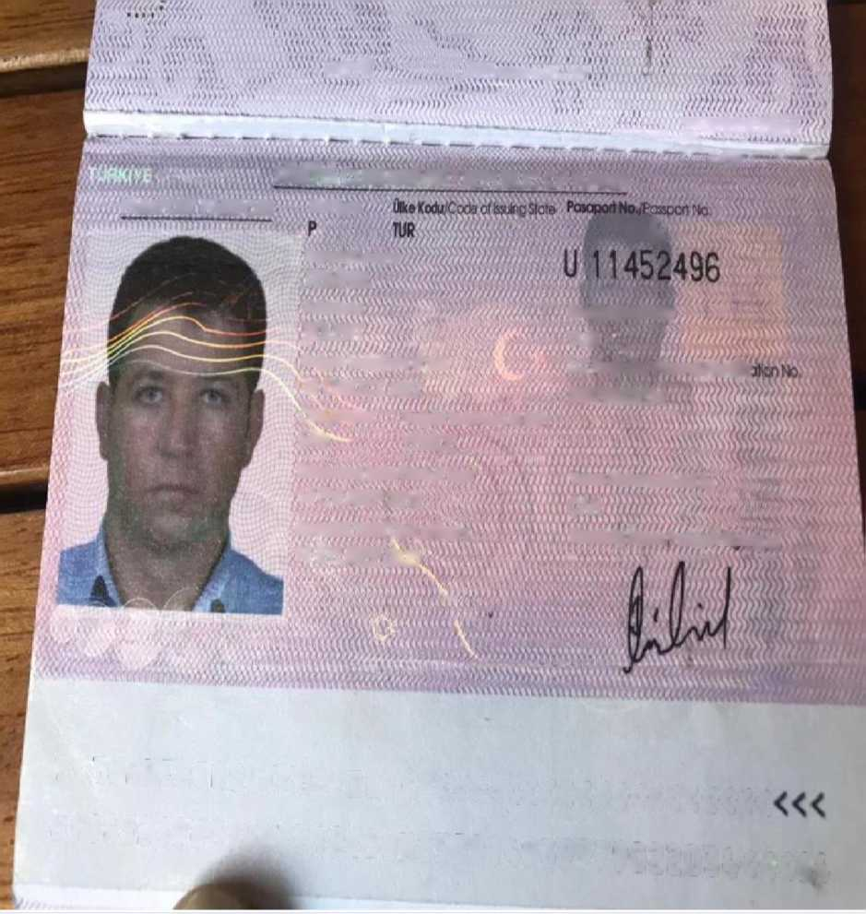
wM
. WSwwwwWAVW
Shwujuxuuu
mwmm/i
Itt^ CUMHURtYETl / REPUBLIC Of TURKEY
XdSfflJ
MSAPOH PASSPORT "Mflype
i?m
sojwa/swncm® ' ■ 'V.
OEMlREL
AdwNorrio v:.'V,/ ■ //,}/₍
BOLENT
wTTTTtjv/ #wTtffii.ftSJ j ■> ■>. . •./ j ffijjfn.
DoflymrarW/DafgotWh !5 EKt/OCT 1977
CVui^/Sex DoSumYefV'PoceofSrti
E/M YENlCE
¹ ‘ nimmiuum L
Mwitome ToW/Date of Issue
14 EYl/SEP 2015
G«9«riiH»< Torthl/Dale of Expiry
14 EYl/SEP 2025
lty[U&u,'Natoro#Y
TUR 7V:'"
T.C Klmlk No.'&as<yK$W^ 39979022034
VwwMokam/teuecl&ii
CAN
Homimip inaoh'htc^iWs^
iv-sa*i\n\v*\\\> ’^{r} ivf.v v\(,ccccccr
P<rURDEHIREL«BULEHT«««««<<<<<<<<<<<
U1T4524960TUR7710159N2509U939979022034<<<64
info@bdkgroup.com.tr
bdkgroup.com.tr
62 of 70 Pages

Slide 7
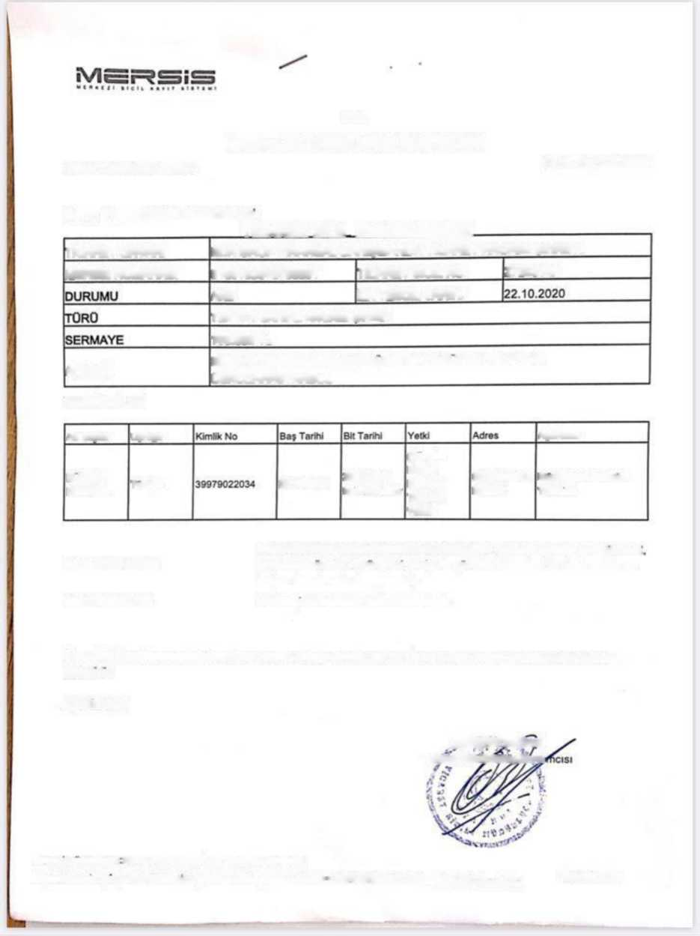
T.C.
Sayi: 2020-GD-70937
ISTANBUL TlCARET SlClLl MODORLOGO
Tarih: 22.10.2020
Konu: Ticaret Sicil Tasdiknamesi
TlHARFT slcli TASDlKNAMESl
TlCARET UNVANI
SDK GRUP FlNANSAL DANIgMANLIK TlCARET ANONlM $lRKETl
MERSlS NUMARASI
0160153670700001
TlCARET SlClL NO
272831-5
NO
Ilk tescIl tarIhi
TEK PAY SAHlPLl ANONlM SlRKET
100.000 TL
ADRESl
SULTANTEPE MAHALLESl MUNlR ERTEGUN SK. NO: 16/3 OSKODAR/ISTANBUL
TEMSlLClLERl
Ad Soyad
Uyru&u
(YoneUm
Kurulu
Bafkam)
Temsile
Yetkil
Aciklama
BUIENT
DEMlREL
Turtciy«
22.10.2020
22.10.2023 lanhino kadar
GONEN/BAL
IKESIR
Munferklen Temsile Yetkilidir.
FAALlYET ALAN I
Ijletme ve diger idarl danijmanlik (aaliyaltari (bir orgartizasyonun stralejik. mail
pazariama, urebm. i? sureplen. proje vfo. yonetim hizmeUeri lie bead marka ve
KISITLAMALARI
imbyaz konularinda damjmanlik)
Herhangi bir kisiUama bulunmamaktadir.
I$ bu Sicil Tasdiknamesinln kayitlara uygun oldu§u tasdik olunur. I$ bu beige yenisi gtkanlmcaya kadar
ge?erlidir.
AQIKLAMA:
BAR^A'RQ»£ks! Ticaret StaaJrfWurJftarcfc
Bolgoyi Duzenleyon BARBAROS EK?I - 22.10.2020 11:43:08
Sayfa 1 /1
https://nicms.gtr.gov.lr/rortal'Dogrulnina?DognilamuKudu * I Hd<)tK)</c00874Ulia50065S24lK'eScb4
info@bdkgroup.com.tr
bdkgroup.com.tr
63 of 70 Pages

Slide 8
Share Distribution;
Title Deed and Plan - Project owner BDK GROUP FINANCIAL CONSULTANCY TRADE is the arrangement of the mutual rights and obligations of the parties within this framework with the promise that the company will transfer all its shares, that is, the 1% shares of the company to the transferees.
Hisse Dagilimi;
Tapu ve Plan - Proje sahibi BDK GRUP FiNANSAL DANI§MANLIK TiC. A.§ tum hisse paylarmi, yani Firmanin %1 hisse paylarinin devralanlara devredecegi vaadi ile bu gergevede taraflarin kar^ilikli hak ve yukumluluklerinin duzenlenmesidir.
PARTIES SIGNATURES: Wednesday08 July, 2021
INVESTOR: | DEVELOPER:
NAME:Mr: | NAME: BULENT DEMIREL
COMPANY: | COMPANY: BDK GRUP FINANSAL
 | DAN.TiCA?
Corporate Title:CEO | Corporate Title: CEO
Date: 08/07/2021 | Date:08/07/2021
info@bdkgroup.com.tr
bdkgroup.com.tr
64 of 70 Pages

Slide 9
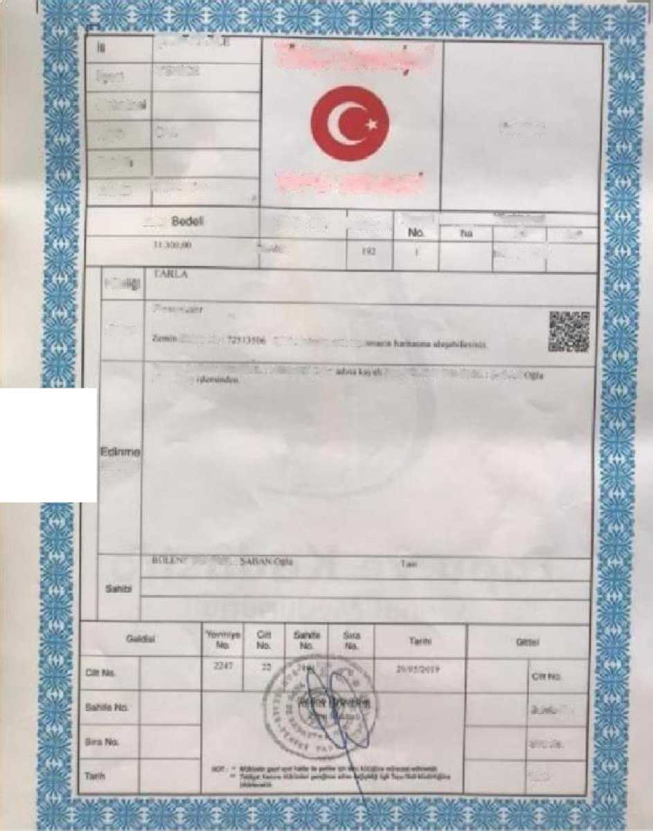
TTCaITaT
Tvifye (Mmet
Ikdftl
\ ( VK i
MnhtK**
F-otafrnl
Kftyii
LAI
S(KS^
Ta
TAPU SENEDt
MvytHi AKkAiVA
Sj|»i
Part* No I Ada Mo
ParM I _vottywc
*r.^{E}
■51*-
Ip I * k*
lim.tlii
w -
HM
l*w IHI.U.U
Viim Vc U**Mlta**i*u.* »w-
TinUM'^AAN m MIA II Ml MMI I (**. .k~ mulHWT in ttiftu MitN
GAYRlMENKUlOM
matfii
Sob«t>i
} III MINI.|
• A* -V
Hki
’♦-'..•I
1*.
?W*>
info@bdkgroup.com.tr
bdkgroup.com.tr
65 of 70 Pages

Slide 10
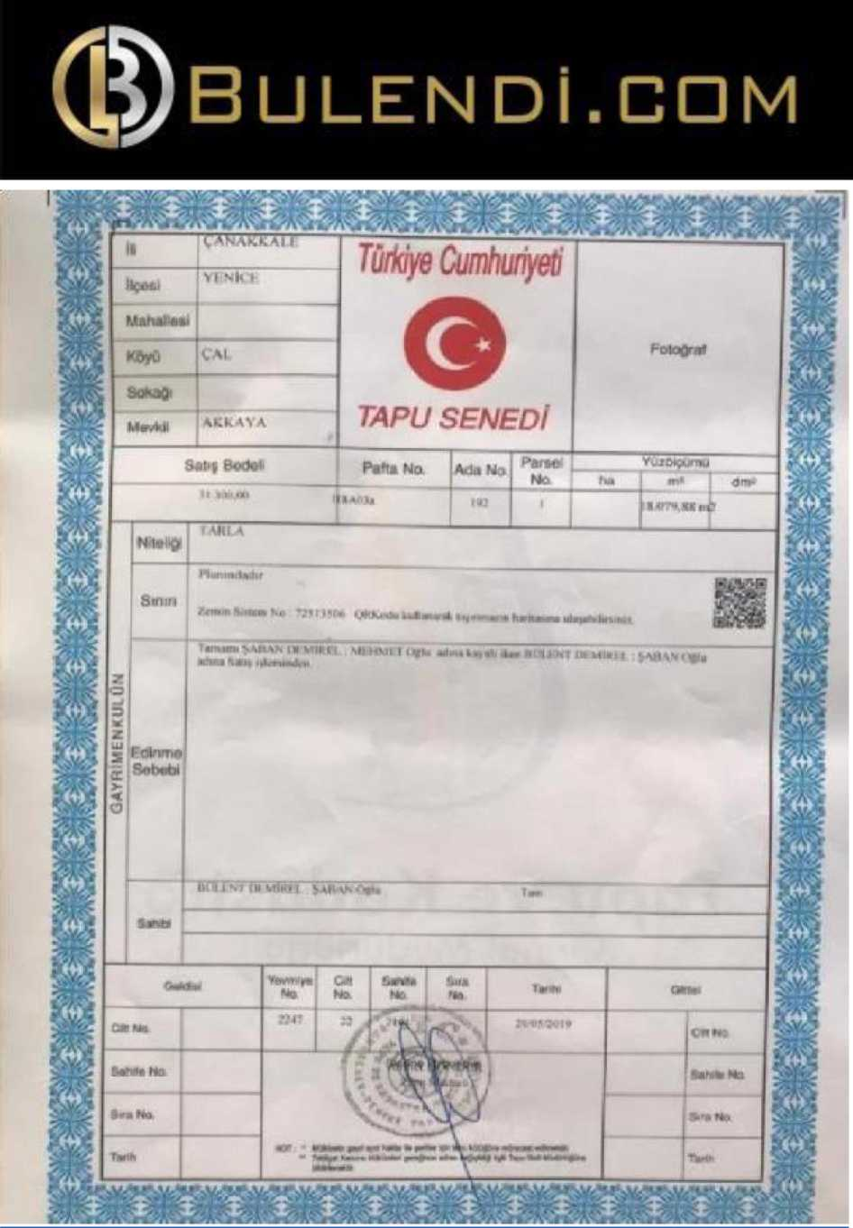
info@bdkgroup.com.tr
bdkgroup.com.tr
66 of 70 Pages

Slide 11
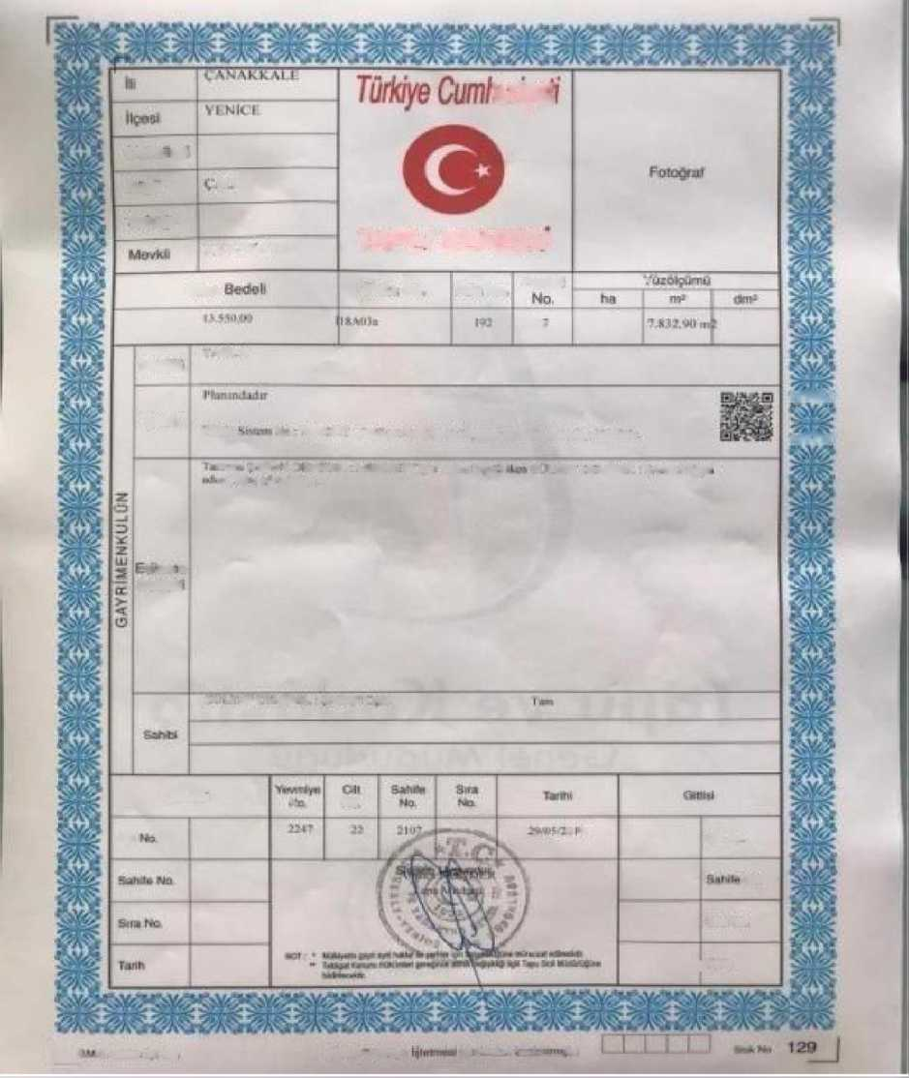
myei
M;irta»e3i
m
KayU
Sowftl
\kkA>A
TAPU SENEDt
Saii^
Pnftri No Arln Nri
Harsei
-
wmm
I uu A
Smiri
VAV
VAy
/min V, • ^751 * j I ? (jRktidi IkulUsimi MMItfU^itl tmliatm kia^dhiltrunj
mam >\H4v i i M1MI L ^ItilVJl F Uf!i *lm* l«s«!. fl» I |^1 I ilMIRH <>ARA\0*l. ^1 Stfftt Nlmuiln
<A* .mum
5nbc:b
m i • vi r'l virw^i v\tw, r»_{r}i.,
G»khu
cm
*■-
H-J
I* M
Da Nek
Nkl
Bit* **n
; T*rti
L_!
n nmmwr ** kid
CHVit* <*fnnn*
\ii n'-HM'i i-l»i.i in i
info@bdkgroup.com.tr
bdkgroup.com.tr
67 of 70 Pages

Slide 12
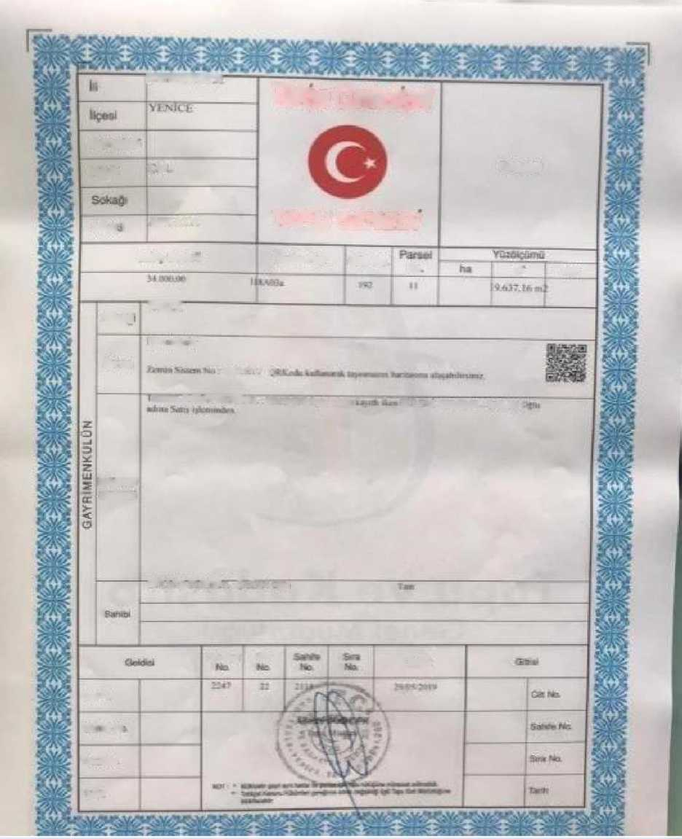
TJT’rTOTTTT
fflcye Cumhunyeti
M abated
*. \l
Randal
KiyO
MM I
AKKAV*
TAPU SENEDt
Sates B«joi»
Pafta Ha Acte No
He
n*r am--
HH
TW7
Sinm
mm wm m
7J5154I? i
wm±\2A\ KMlfcf i vti i iwrr< ** m* a< i.-rt RWl $ws«
EitrT'fn#
Sflbrbi
BM'IMWW! 5-..H v- - ^
.
Wrfliirf -or
ItaVt
C« tte.
mm m m
KnMA
T®**
info@bdkgroup.com.tr
bdkgroup.com.tr
68 of 70 Pages

Slide 13
Devir Bedeli;
Plan - Proje genel bedeli 1.004.000.000 €
Proje ortaklarinin projeye katilim sagladigi tarihte TC Merkez Bankasindan guncel kur alinarak Sosyal Aktivite - Yajam Koyu hisselerine odeme yapilacaktir. Ana hisseler Tapu ve Plan -Proje sahibi BDK GRUP FiNANSAL DANI$MANLIK TiC. A.§ 'in GRANTl BBVA € TR62 0006 2000 7400 0009 0625 92 hesabina proje bedelidir diye defaten odemelerini yapacaklardir. Bir hisseyi tamamlayamayan yatirimalanmizm sonrasinda tekrarinda defaten yapacaklari odemelerini bir hisse sahibi olacaklardir. Sozlejmenin imzalandigi tarihten itibaren 5 ( bej ) ijgununu muteakiben BDK GRUP FiNANSAL DANI§MANLIK TiCARET ANONiM JiRKETi'in GARANTl BBVA € TR62 0006 2000 7400 0009 0625 92 transfer yapilacaktir. Yukumluklerini yerine getiremeyen yatirimci taraf, Tapu ve Plan - Proje sahibi BDK GRUP FiNANSAL DANI§MANLIK TlC.A.§ sozlejmeyi tek tarafli fesih etme hakkina sahiptir ve tum yapilan harcamalar finansmani saglayan yatirimcilardan masraf olarak talep edecektir.
Transfer Free;
Plan - Project overall cost 1.004.000.000 €
On the date when the project partners participated in the project, a current exchange rate will be received from the Central Bank of the Republic of Turkey and payment will be made to the shares of Social Activity - Life Village. Main shares Land and Plan - Project owner BDK GROUP FINANCIAL CONSULTANCY TRADE will make their payments to GARANTI BBVA € TR62 0006 2000 7400 0009 0625 92 account in advance for the project price. Our investors, who cannot complete a share, will have a share in their payments once again. A transfer will be made to the BDK GROUP FINANCIAL CONSULTANCY TRADE INC. GARANTI BBVA
€ TR62 0006 2000 7400 0009 0625 92 transfer
will be made. Investor who fails to fulfill its
obligations, Title Deed and Plan - Project
owner
Uyu$mazlik Hali;
BDK GRUP FINANCIAL CONSULTANCY TICARET ANONIM SIRKETI
Ijbu Sozlejmeden kaynaklanabilecek uyujmazliklarin gozumunde ISTANBUL Mahkemeleri ve Icra Daireleri yetkilidir.
, the investor who fails to fulfill its obligations, the Title Deed and Plan - Project owner, has the right to terminate the contract unilaterally and all expenses will be charged to the investors who provide the financing.
Ijbu sozlejme 08 Temmuz 2021 tarihinde taraflarca mutabik kalinarak 7 ( yedi ) sayfa ve iki nusha olarak imzalanmijtir.
Conflict Status;
info@bdkgroup.com.tr
bdkgroup.com.tr
69 of 70 Pages

Slide 14

istanbul Courts and Enforcement Offices are authorized to resolve any disputes that may arise from this Agreement.
This agreement has been signed by the parties on 08 July 2021 in 7 (seven) pages and two copies.
BDK GRUP FiNANSAL DANI$MANLIK TiC.A.$
BDK GROUP FINANCIAL CONSULTANCY TRADE FiRMA SAHiBi: Bulent DEMiREL
Yatirimci Finansor Investor Financier
info@bdkgroup.com.tr
bdkgroup.com.tr
70 of 70 Pages

